Slide 1
Lessons learnt at building recommendation services at industry scale
Domonkos Tikk
Gravity R&D
Industry keynote @ ECIR 2016
@domonkostikk

Slide 2





Credits to colleagues
Bottyán Németh
Product Owner and co-founder
Gábor Vincze
Head of Global Service
István Pilászy
Head of Development and co-founder
György Dózsa
Head of Web Integrations
Balázs Hidasi
Head of Data Mining & Research
and many others…

Slide 3

IR $⊃$
IR ?
Recsys
Information Retrieval without query

Slide 4
Who we are and what we do
Gravity R&D is a recommender system vendor company
We provide recommendation as a service since 2009 for our customers all around the globe

Slide 5

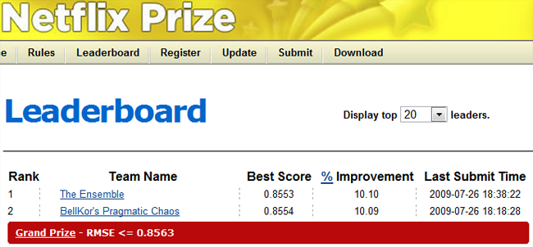
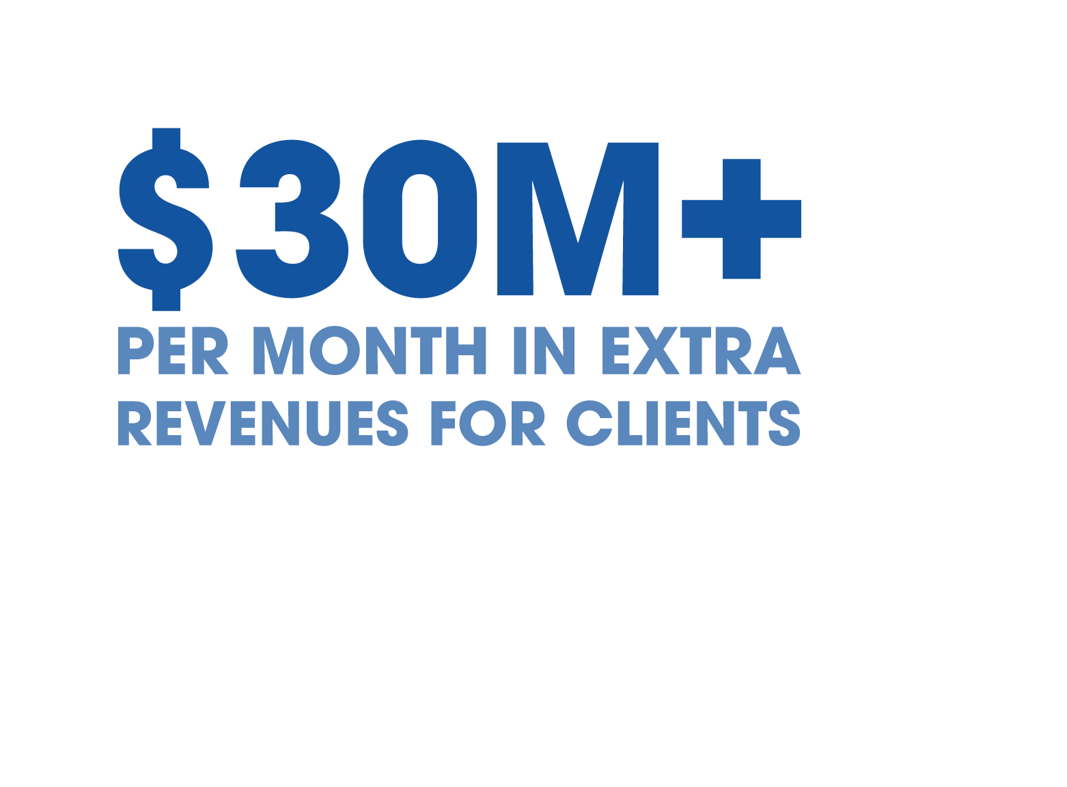

The journey Gravity made from 2009-2016
2009
2016

Slide 6
How we imagine growth?
?

Slide 7

How we imagine growth?

Slide 8
How it actually happens?
?

Slide 9
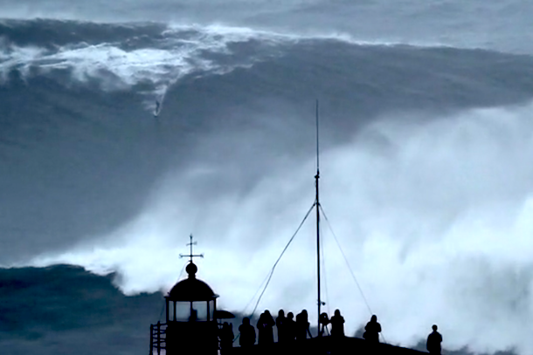
How it actually happens?

Slide 10
The impact of Netflix Prize

Slide 11

Short summary of Netflix Prize
2006–2009
Predict movie ratings (explicit feedback)
Content based filtering (CBF) did not work
Classical CF methods (item-kNN, user-kNN) did not work
Matrix factorization was extremely effective
We were fully in love with matrix factorization

Slide 12
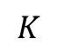

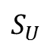
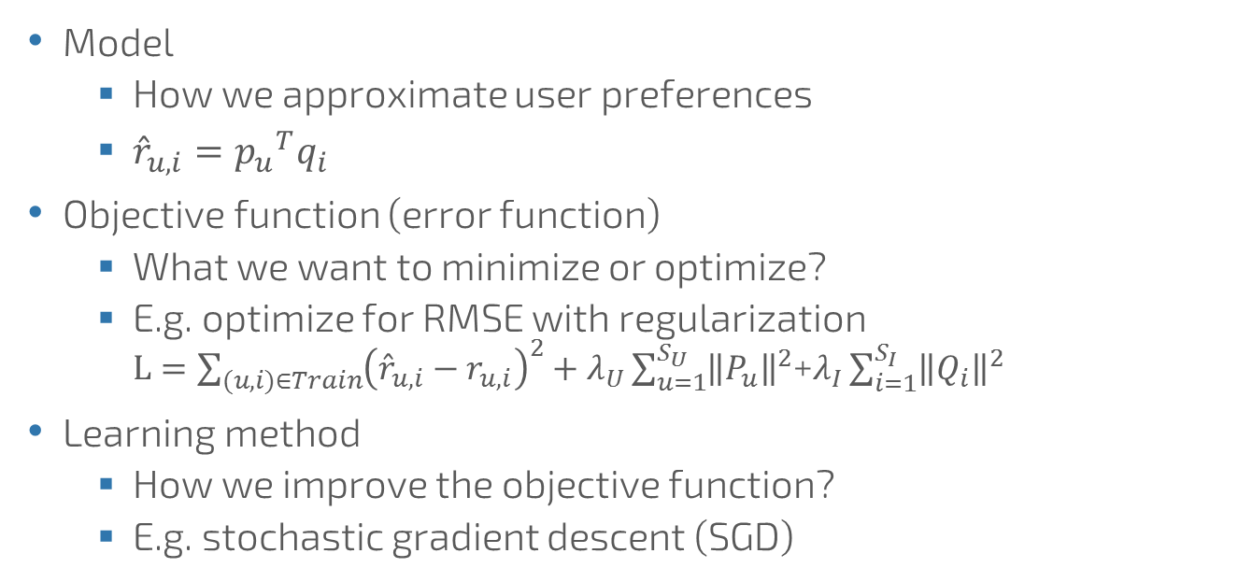
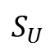
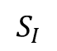
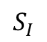
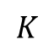
Schematic of matrix factorization
Q
$$K$$
Model
How we approximate user preferences
${\hat{r}}_{u,i}={p_{u}}^{T}q_{i}$
Objective function (error function)
What we want to minimize or optimize?
E.g. optimize for RMSE with regularization $L=\sum_{(u,i)∈Train}{{\left({\hat{r}}_{u,i}−r_{u,i}\right)}^{2}}+λ_{U}\sum_{u=1}^{S_{U}}{{\left\|P_{u}\right\|}^{2}}$+$λ_{I}\sum_{i=1}^{S_{I}}{{\left\|Q_{i}\right\|}^{2}}$
Learning method
How we improve the objective function?
E.g. stochastic gradient descent (SGD)
R
$$≈$$
$$S_{U}$$
P
$$S_{U}$$
$$S_{I}$$
$$S_{I}$$
$$K$$
Learning

Slide 13





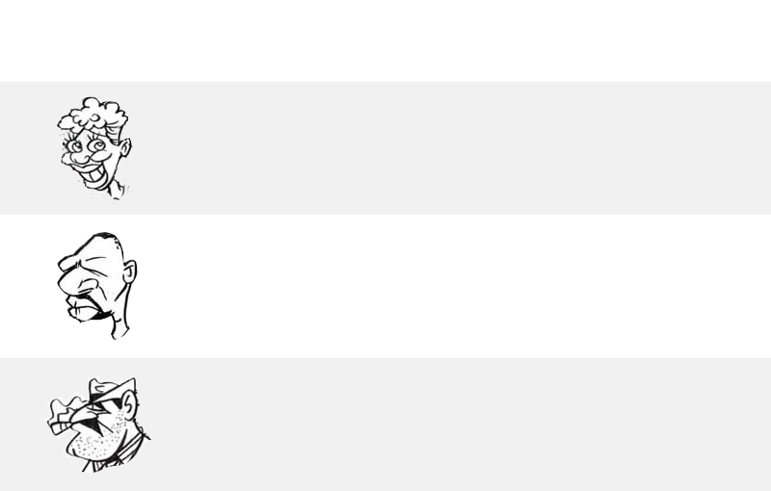
R
P
1
4
3
1.2 -0.5
1.1 -0.4
1.2 -0.3
1.1 -0.2
4
4
1.2 0.9
1.2 0.9
1.1 0.8
0.5 -0.3
0.5 -0.1
0.4 -0.4
4
2
4
0.4 -0.2
1.4
1.3
1.5
0.8
0.9
-1.3
-1.2
-1.1
0.0
0.1
-0.1
0.5
0.6
Q
-0.2
-0.1
0.0
0.5
0.4
-0.4
-0.3
-0.2
1.6
1.5
1.6
0.3
0.2
Notes:
13

Slide 15
R
P
1
4
3.3
3
2.4
1.4 1.1
-0.5
3.5
4
4
1.5
0.9 1.9
4
4.9
2
1.1
4
2.5 -0.3
1.5
2.1
1.0
0.7
1.6
Q
-1.0
0.8
1.6
1.8
0.0
Notes:
15

Slide 16

Make investors interested
Reference
Team
Technology
Business model

Slide 17
Netflix Prize demo / 1
In 2009 we created a public demo mainly for investors
Users can rate movies and get recommendations
What do you expect from a demo?
Be relevant even after 1 rating
Users will provide their favorite movies first
Be relevant after 2 ratings: both movies should affect the results

Slide 18
Netflix Prize demo / 2
Using a good MF model with K=200 factors and biases
Use linear regression to compute user feature vector
Recs after rating a romantic movie Notting Hill, 1999
OK | Score | Title
✓ | 4.6916 | The_Shawshank_Redemption/1994
✗ | 4.6858 | House,_M.D.:_Season_1/2004
✗ | 4.6825 | Lost:_Season_1/2004
✓ | 4.5903 | Anne_of_Green_Gables:_The_Sequel/1987
✗ | 4.5497 | Lord_of_the_Rings:_The_Return_of_the_King/2003

Slide 19
Netflix Prize demo / 3
Idea: turn off item bias during recommendation.
Result are fully relevant
Even with 10 factors, it is very good
OK | Score | Title
✓ | 4.3323 | Love_Actually/2003
✓ | 4.3015 | Runaway_Bride/1999
✓ | 4.2811 | My_Best_Friend's_Wedding/1997
✓ | 4.2790 | You've_Got_Mail/1998
✓ | 4.1564 | About_a_Boy/2002

Slide 20
Netflix Prize demo / 4
Now give 5-star rating to Saving Private Ryan / 1998
Almost no change in the list
OK | Score | Title
✓ | 4.5911 | You've_Got_Mail/1998
✓ | 4.5085 | Love_Actually/2003
✓ | 4.3944 | Sleepless_in_Seattle/1993
✓ | 4.3625 | Runaway_Bride/1999
✓ | 4.3274 | My_Best_Friend's_Wedding/1997

Slide 21
Netflix Prize demo / 5
Idea: set item biases to zero before computing user feature vector
5th rec is romantic + war
Conclusion: MF is good, but rating and ranking are very different
OK | Score | Title
✓ | 4.5094 | You've_Got_Mail/1998
✓ | 4.3445 | Black_Hawk_Down/2001
✓ | 4.3298 | Sleepless_in_Seattle/1993
✓ | 4.3114 | Love_Actually/2003
✓! | 4.2805 | Apollo_13/1995

Slide 22
The rough start

Slide 23


The business model question
Trabant
Rolls Royce

Slide 24
Business model: Trabant vs. Rolls Royce
Cheap for client
Simple functionality
Low performance
No customization
Limited warranty
Works if sold in large quantities
Expensive for client
Complex functionality
High performance
Fully customization
Full warranty (SLA)
Few sales can bring enough return

Slide 25
Our decision in 2009 was: Rolls Royce
Expensive for client
Complex functionality
High performance
Fully customization
Full warranty (SLA)
Few sales can bring enough return

Slide 26
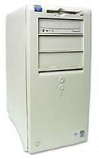
# of requests
Vatera.hu largest online marketplace in Hungary served by one “server”
Alexa TOP100 video chat webpage (~40M recommendation requests / day):
Served by 5 application servers and 1 DB
Too many events to store in MySQL → using Cassandra (v0.6)
Training time for IALS too long → speedup by IALS1
Max. 5 sec latency in “product” availability

Slide 27
Using new/beta technologies
Cassandra (v0.6)
Nginx (v0.5) (22% of top 1M sites)
Kafka (v0.8)
MySQL auto. failover

Slide 28
Reaching the limits
Even if the technology is widely used if you reach its limits the optimization is very costly / time consuming.
Java GC – service collapsed because increased minor GC times due to a JVM bug (26th of January 2013)
Maintaining MySQL with lots of data (optimize table, slave replication lag, faster storage device)

Slide 29

Complexity increases
There is always a business request or an algorithmic development which requires more resources.

Slide 30
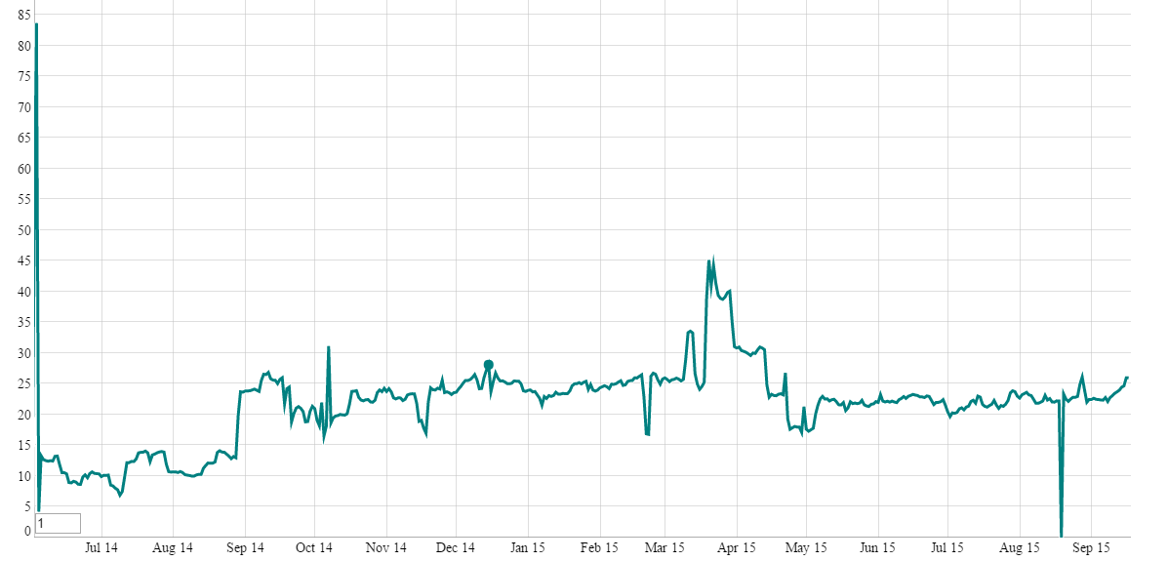
Optimizations

Slide 31
# of items
How to store item model / metadata in memory to serve requests fast?
VS.
Auto increment IDs for the items?
2³¹ (~2 billions) is not enough

Slide 32

Preconceptions
More data yield better results
CTR is the right proxy: quick decision on A/B tests
Daily retrain is enough
Notes:
Little people last sayings

Slide 33
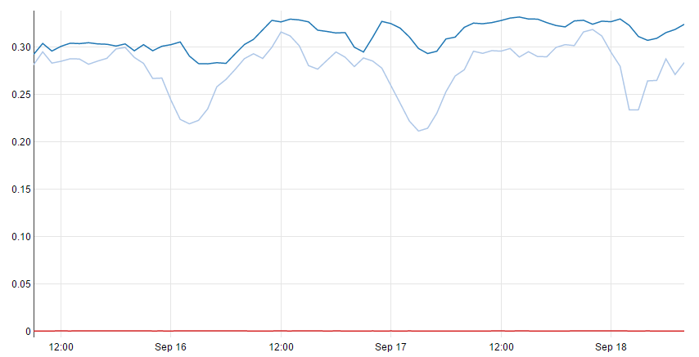
Training frequency
CTR decreased in the morning

Slide 34
Tasks are different in real-world applications

Slide 35
Industry vs. academia
In Academic papers
50% explicit feedback
50% implicit feedback
49.9% personal
0.1% item2item
At gravityrd.com:
1% explicit feedback
99% implicit feedback
15% personal
84% item2item
Sites where rating is crucial tend to create their own rec engine
Even if there is explicit rating, there are more implicit feedback

Slide 36
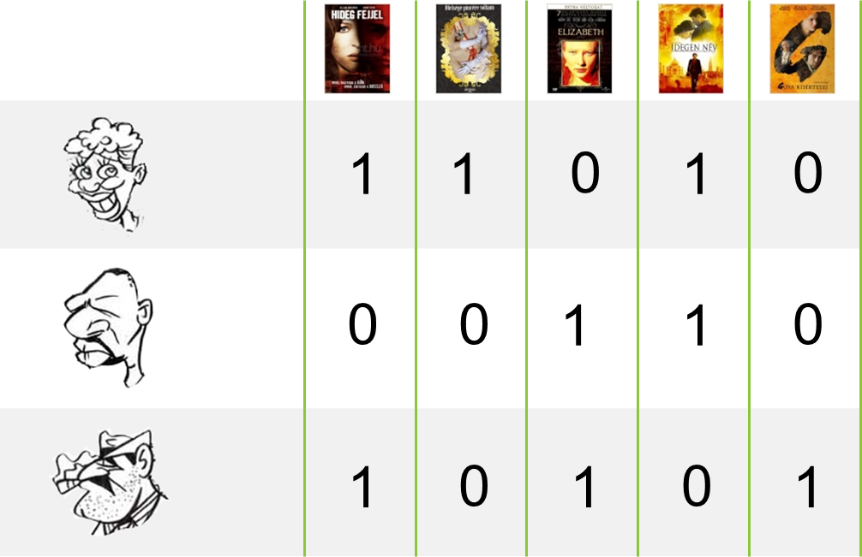
Implicit vs. explicit ratings
Standard SGD based learning does not work (complexity issues)
Implicit ALS
Approximate versions of IALS
with coordinate descent*
with conjugate gradient**
* I Pilászy, D Zibriczky, D Tikk, Fast ALS-based matrix factorization for explicit and implicit feedback datasets, RecSys 2010,
** G Takács, I Pilászy, D Tikk, Applications of the conjugate gradient method for implicit feedback, collaborative filtering, RecSys 2011,

Slide 37
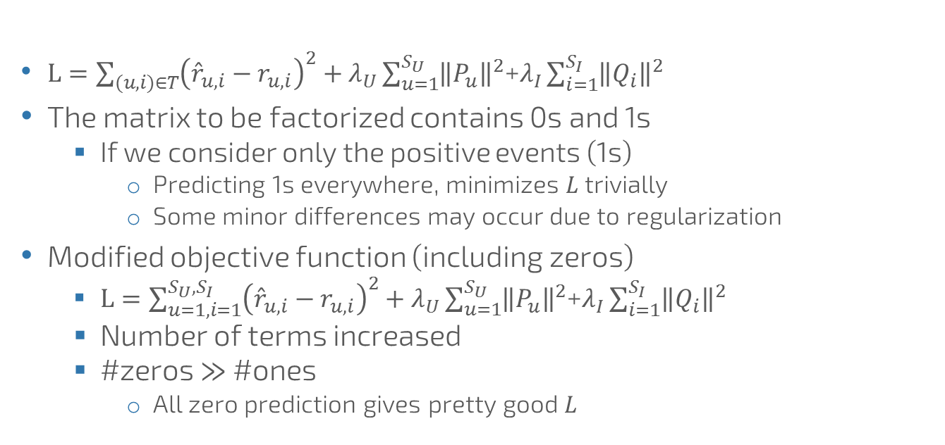
What is the problem with the explicit objective function
$L=\sum_{(u,i)∈T}{{\left({\hat{r}}_{u,i}−r_{u,i}\right)}^{2}}+λ_{U}\sum_{u=1}^{S_{U}}{{\left\|P_{u}\right\|}^{2}}$+$λ_{I}\sum_{i=1}^{S_{I}}{{\left\|Q_{i}\right\|}^{2}}$
The matrix to be factorized contains 0s and 1s
If we consider only the positive events (1s)
Predicting 1s everywhere, minimizes $L$ trivially
Some minor differences may occur due to regularization
Modified objective function (including zeros)
$L=\sum_{u=1,i=1}^{S_{U},S_{I}}{{\left({\hat{r}}_{u,i}−r_{u,i}\right)}^{2}}+λ_{U}\sum_{u=1}^{S_{U}}{{\left\|P_{u}\right\|}^{2}}$+$λ_{I}\sum_{i=1}^{S_{I}}{{\left\|Q_{i}\right\|}^{2}}$
Number of terms increased
#zeros $≫$ #ones
All zero prediction gives pretty good $L$

Slide 38
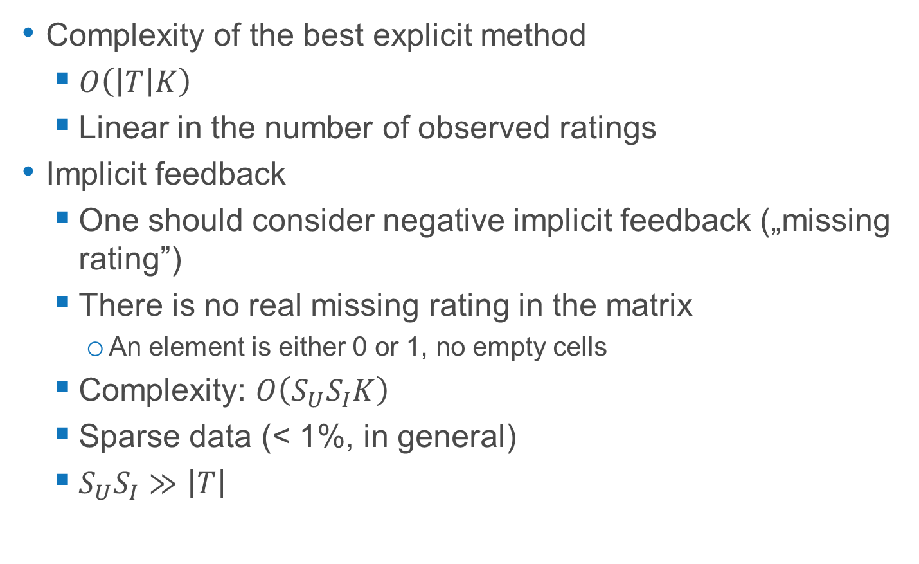
Why „explicit” optimization suffers
Complexity of the best explicit method
$O\left(\left|T\right|K\right)$
Linear in the number of observed ratings
Implicit feedback
One should consider negative implicit feedback („missing rating”)
There is no real missing rating in the matrix
An element is either 0 or 1, no empty cells
Complexity: $O\left(S_{U}S_{I}K\right)$
Sparse data (< 1%, in general)
$S_{U}S_{I}≫\left|T\right|$

Slide 39
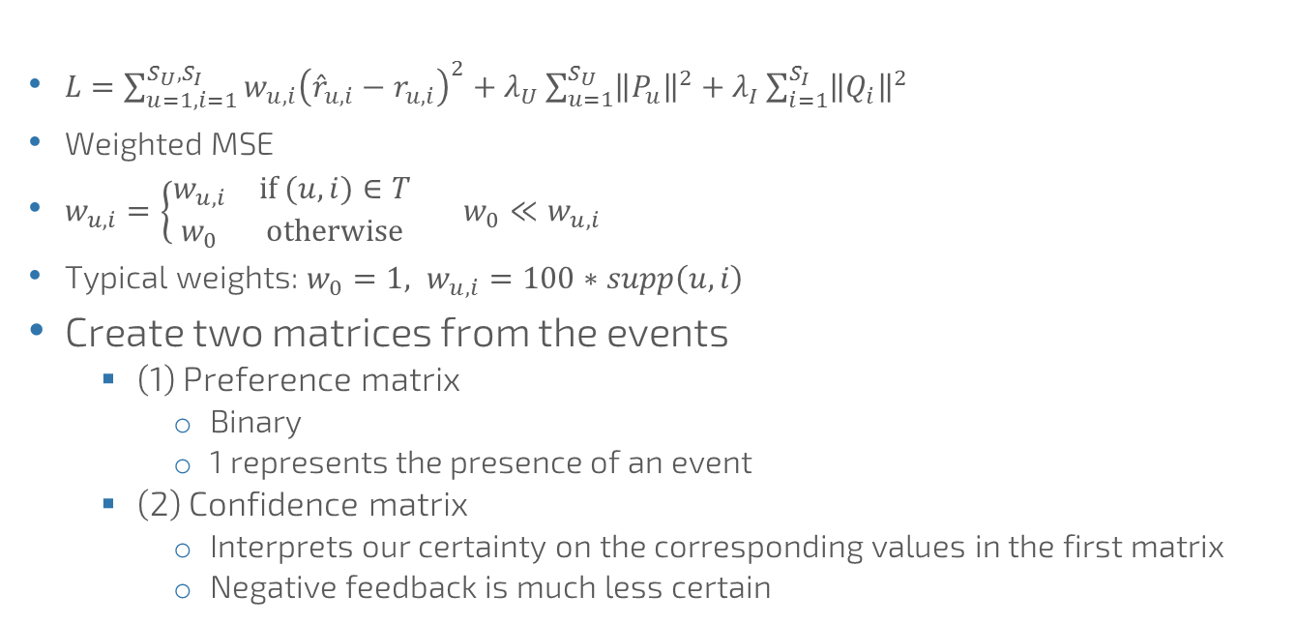
iALS – objective function
$L=\sum_{u=1,i=1}^{S_{U},S_{I}}{{w_{u,i}\left({\hat{r}}_{u,i}−r_{u,i}\right)}^{2}}+λ_{U}\sum_{u=1}^{S_{U}}{{\left\|P_{u}\right\|}^{2}}+λ_{I}\sum_{i=1}^{S_{I}}{{\left\|Q_{i}\right\|}^{2}}$
Weighted MSE
$w_{u,i}=\left\{\begin{matrix}w_{u,i} & \text{if} (u,i)∈T \\ w_{0} & \text{otherwise}\end{matrix}\right.$ $w_{0}≪w_{u,i}$
Typical weights: $w_{0}=1, w_{u,i}=100∗supp\left(u,i\right)$
Create two matrices from the events
(1) Preference matrix
Binary
1 represents the presence of an event
(2) Confidence matrix
Interprets our certainty on the corresponding values in the first matrix
Negative feedback is much less certain

Slide 40
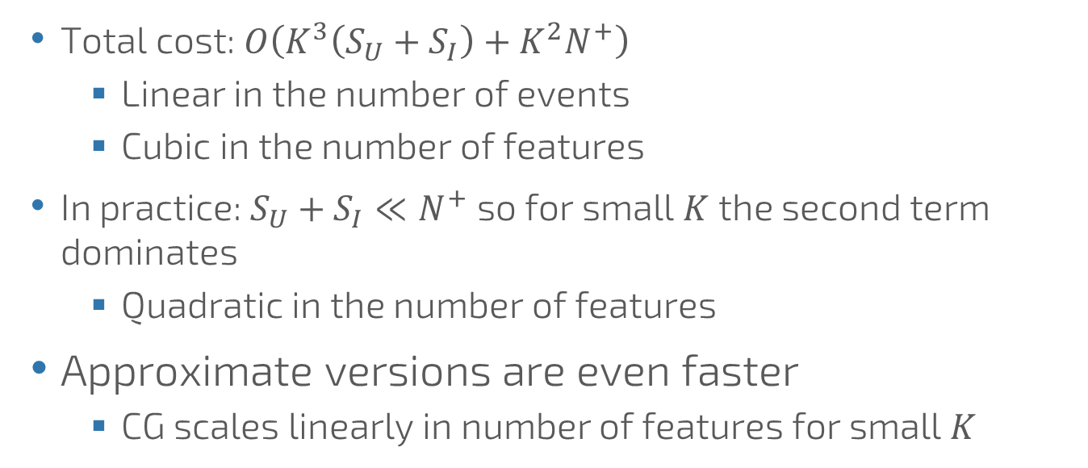
Complexity of iALS
Total cost: $O\left(K^{3}\left(S_{U}+S_{I}\right)+K^{2}N^{+}\right)$
Linear in the number of events
Cubic in the number of features
In practice: $S_{U}+S_{I}≪N^{+}$ so for small $K$ the second term dominates
Quadratic in the number of features
Approximate versions are even faster
CG scales linearly in number of features for small $K$

Slide 41
Training time using speed-ups
~1000 users
~170k items
~19M events

Slide 42
Item-2-item scenario

Slide 43
Task 2: item-2-item recommendations
What is item-to-item recommendation?
People who viewed this also viewed: …
Viewed, watched, purchased, liked, favored, etc.
Ignoring the current user
The recommendation should be relevant to the current item
Very common scenario

Slide 44
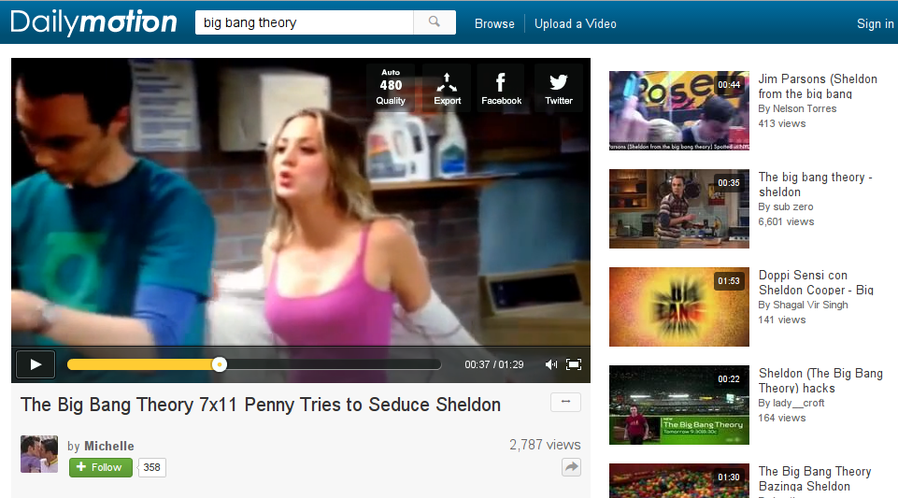

Slide 45
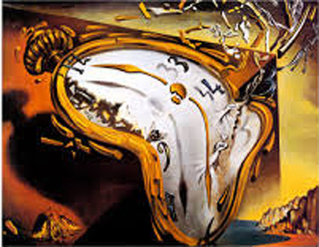
Data volume and time
Data characteristics (after data retention):
Number of active users: 100k – 100M
Number of active items : 1k – 100M
Number of relations between them: 10M – 10B
Response time: must be within 200ms
We cannot give 199ms for MF prediction + 1ms business logic

Slide 46
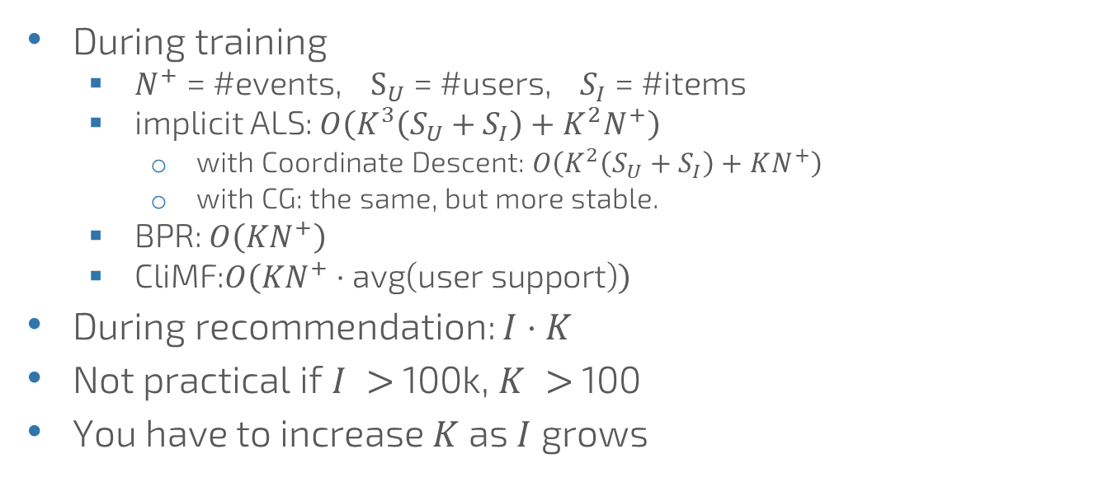
Time complexity of MF for implicit feedback
During training
$N^{+}$ = #events, $S_{U}$ = #users, $S_{I}$ = #items
implicit ALS: $O\left(K^{3}\left(S_{U}+S_{I}\right)+K^{2}N^{+}\right)$
with Coordinate Descent: $O\left(K^{2}\left(S_{U}+S_{I}\right)+KN^{+}\right)$
with CG: the same, but more stable.
BPR: $O\left(KN^{+}\right)$
CliMF:$O\left(KN^{+}⋅\text{avg}\text{(}\text{user} \text{support}\text{)}\right)$
During recommendation: $I⋅K$
Not practical if $I >$ 100k, $K >$ 100
You have to increase $K$ as $I$ grows

Slide 47
i2i recommendations with SVD / 2
Recommendations should seem relevant
You can expect that movies of the same trilogy are similar to each other
We defined the following metric:
For movies A and B of a trilogy, check if B is amongst the top-5 most similar items of A. Score: 0 or 1
A trilogy can provide 6 such pairs (12 for tetralogies)
Sum up this for all trilogies
We used a custom movie dataset
Good metric for CF item-to-item, bad metric for CBF item-to-item

Slide 48
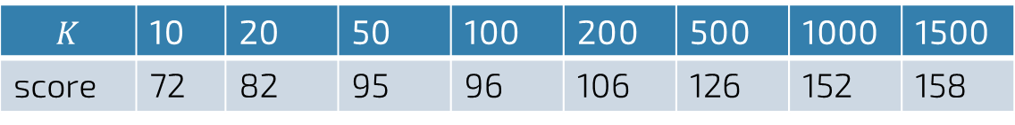
i2i recommendations with SVD / 3
Evaluating for SVD with different number of factors
Using cosine similarity between SVD feature vectors
more factors provide better results
Why not use the original space?
Who wants to run SVD with 500 factors?
Score of neighbor method (using cosine similarity between original vectors): 169
$$K$$ | 10 | 20 | 50 | 100 | 200 | 500 | 1000 | 1500
score | 72 | 82 | 95 | 96 | 106 | 126 | 152 | 158

Slide 49
I2i recommendations with SVD / 4
What does a 200-factor SVD recommend to Kill Bill: Vol. 1
Really bad recommendation
OK | Cos Sim | Title
✓ | 0.299 | Kill Bill: Vol. 2
✗ | 0.273 | Matthias, Matthias
✗ | 0.223 | The New Rijksmuseum
✗ | 0.199 | Naked
✗ | 0.190 | Grave Danger

Slide 50
i2i recommendations with SVD / 5
What does a 1500-factor SVD recommend to Kill Bill: Vol. 1
Good, but uses lots of CPU
But that is an easy domain, with 20k movies!
OK | Cos Sim | Title
✓ | 0.292 | Kill Bill: Vol. 2
✓! | 0.140 | Inglourious Basterds
✓! | 0.133 | Pulp Fiction
✗ | 0.131 | American Beauty
✓! | 0.125 | Reservoir Dogs

Slide 51
Implementing an item-to-item method / 1
We implemented the following article:
Noam Koenigstein and Yehuda Koren. "Towards scalable and accurate item-oriented recommendations." Proceedings of the 7th ACM conference on Recommender systems. ACM, 2013.
They define a new metric for i2i evaluation: MPR (Mean Percentile Rank): If user visits A, and then B, then recommend for A, and see the position of B in that list.
They propose a new method (EIR, Euclidean Item Recommender) , that assigns feature vector for each item, so that if A is close to B, then users frequently visit B after A.
They don’t compare it with pure popularity method

Slide 52
Implementing an item-to-item method / 2
Results on a custom movie dataset:
SVD and other methods can’t beat the new method
Popularity method is better or on-pair with the new method
Recommendations for Pulp Fiction:
SVD | New method
Reservoir Dogs | A Space Odyssey
Inglourious Basterds | A Clockwork Orange
Four Rooms | The Godfather
The Shawshank Redemption | Eternal Sunshine of the Spotless Mind
Fight Club | Mulholland Drive

Slide 53
Implementing an item-to-item method / 3
Comparison
method | metadata similarity (larger is better) | MPR (smaller is better)
cosine | 7.54 | 0.68
Jaccard | 7.59 | 0.68
Association rules | 6.44 | 0.68
pop | 1.65 | 0.25
random | 1.44 | 0.50
EIR | 5.00 | 0.25

Slide 54
Summary of EIR
This method is better in MPR than many other methods
It is on pair with Popularity method
It is worse in metadata-based similarity
Sometimes recommendations look like they were random
Sensitive to the parameters
Very few articles are dealing with CF item-to-item recs

Slide 55
Case studies on CTR

Slide 56
Case studies on CTR / 1
CTR almost doubled when we switched from IALS1 to item-kNN on a site where users and items are the same

Slide 57
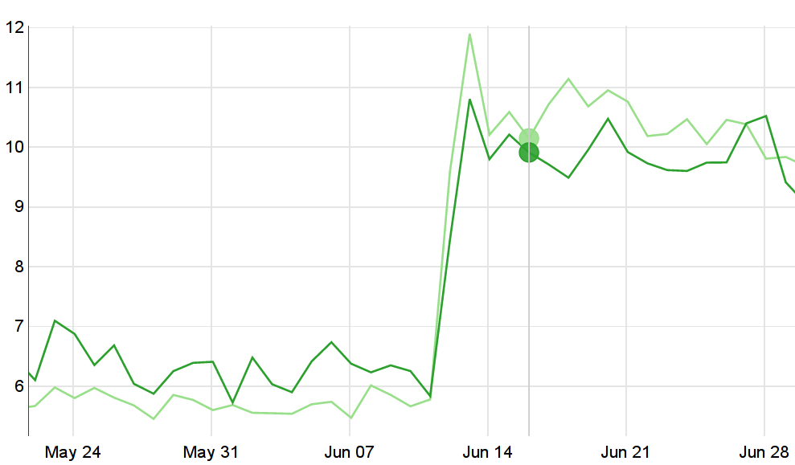

Slide 58
Case studies on CTR / 2
Comparison of BPR vs. item-kNN on a classified site, for item-to-item recommendations
Item-kNN is the winner

Slide 59
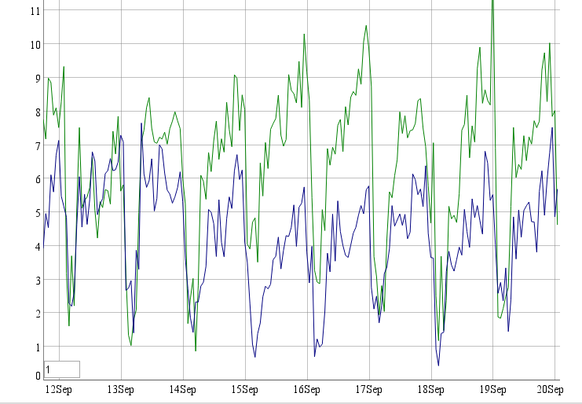
Item-kNN
BPR

Slide 60
Case studies on CTR / 3
Using BPR vs. item-kNN on a video site for personal recommendations
Measuring number of clicks on recommendations
Result: 4% more clicks for BPR

Slide 61
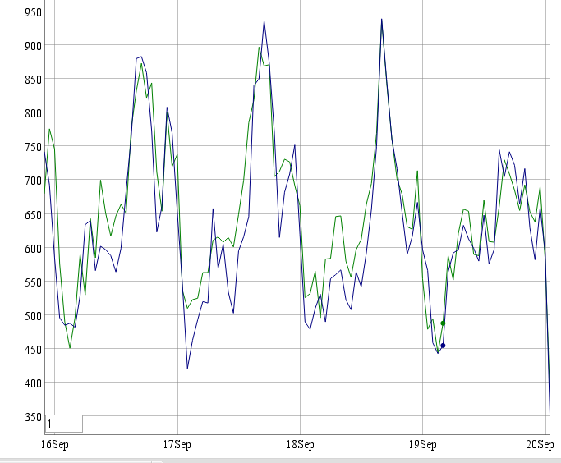
BPR
Item-kNN

Slide 62
Critiques of MF
Lots of parameters to tune
Needs many iteration over the data
If there is no inter-connection between two item sets, they can get similar feature vectors.
Sensitive to noise in data and cold-start
Not the best for item-to-item recs, especially when many neighbors already exist

Slide 63
When to use MF
One dense domain (e.g. movies), with not too many items (e.g. less than 100k)
Feedback is taste-based
For personalized recommendations (e.g. newsletter)
Do always A/B testing
Smart blending (e.g. using it for high supported items)
Usually better for offline evaluation metrics

Slide 64
Where we are now

Slide 65




Gravity’s Products and Features
Omnichannel Recommendations
Mobile / Desktop / iPhone & Android Apps
Dynamic & personalized retargeting
Through ad networks and third party sites
Smart Search
Autocomplete, Autocorrect, Search result re-ranking
Personalized Emails & Push Notifications

Slide 66
Technology overview
Performance: Gravity’s performance oriented architecture enables real-time response to the always changing environment and user behavior
Algorithms: more than 100 different recommendation algorithm enables true personalization and to reach the highest KPIs in different domains
Infrastructure: fast response times all around the globe and data security thanks to the private cloud infrastructure located in 4 different data centers
Flexibility: the advanced business rule engine with intuitive user interface allows to satisfy various business requirements
Performance
140M requests served daily
Algorithms
30 man-years invested
Infrastructure
4 data centers globally
Flexibility
100s of logics configurable

Slide 67
Infrastructure
Currently 200+ hosts and 3500+ services monitored

Slide 68


4 data centers around the globe
AMS
60+ servers
BUD
80+ servers
SIN
30+ servers
SJC
20+ servers

Slide 69
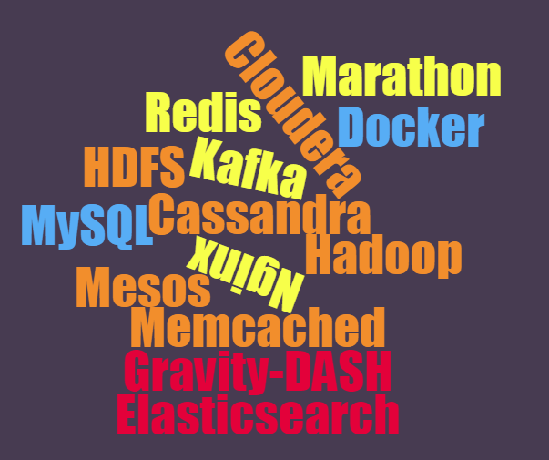
Using lots of technologies

Slide 70
Using lots of algorithms (100+)

Slide 71
New directions

Slide 72
Deep learning: Session based recommendations
User profile → separate sessions
User identification problem
Sessions of different purposeses
Buy for herself / present
Purchase products that specify a need (e.g. TV now, fridge 2 weeks later)
Intent / goal of a browsing sessions of the same user can be different
Usual solution: Item-to-item recommendations
Previous history is not considered
No personalized experience
Extra round for finding the best fit
Next event prediction:
Given the events in the session (so far) what is the next most likely event?

Slide 73
Session based recommendations with RNN
Output: scores on items
Feedforward layers
Item-to-session recommendations
Using RNNs (GRU, LSTM)
Network with many features
Distinctive features
Session-parallel mini-batches
Sampling on the output layer
Ranking loss
BPR
TOP1
GRU layer
…
GRU layer
GRU layer
Embedding layer
Input: actual item, 1-of-N coding

Slide 74
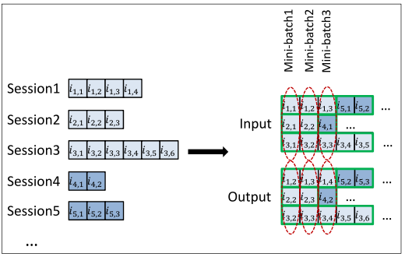
Session-parallel mini-batches
*Balázs Hidasi, Alexandros Karatzoglou, Linas Baltrunas, Domonkos Tikk: Session-based Recommendations with Recurrent Neural Networks, to appear at ICLR 2016, available on Arxiv.

Slide 75
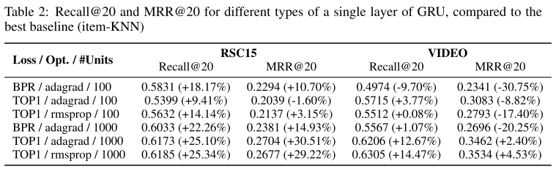
Results
Significant improvement over the baselines
+20-30% in recall@20 and MRR@20 over item-kNN

Slide 76
Direct usage of content for recommendations
User’s decision (click or not click)
Title
Image
Description
Pipeline
Automatic feature extraction from content (text, images, music, video)
Feed features to the RNN recommender
Other usages
„Truly similar” item recommendation
„X is to Y like A is to B” recommendations
Etc.
High potential

Slide 77
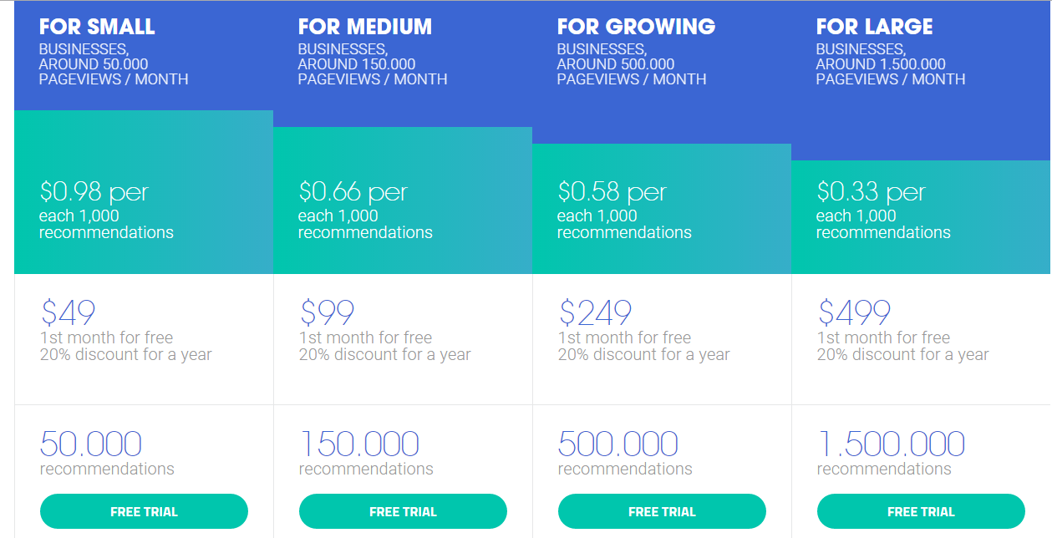
Recoplatform: RaaS for SMBs
www.recoplatform.com
Self service solution
Automated quick and easy integration
Priced to scale with business size

Slide 78
Technology
Business model
Algorithms
Product

Slide 79
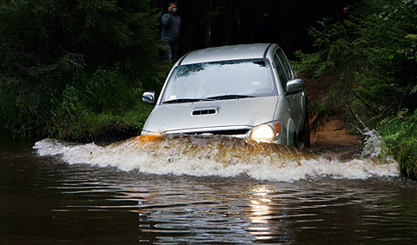
Cross the river when you come to it

Slide 80

Thank you!
Email: domi@gravityrd.com
Twitter: @domonkostikk
Web: www.gravityrd.com
F: facebook.com/gravityrd
Blog: blog.gravityrd.com
Yes, we are hiring: hr@gravityrd.com

